Slide 1

CHAPTER 7
FUNCTIONS
Copyright © Cengage Learning. All rights reserved.

Slide 2
SECTION 7.3
Composition of Functions
Copyright © Cengage Learning. All rights reserved.

Slide 3
Composition of Functions
Consider two functions, the successor function and the squaring function, defined from Z (the set of integers) to Z, and imagine that each is represented by a machine.
If the two machines are hooked up so that the output from the successor function is used as input to the squaring function, then they work together to operate as one larger machine.
In this larger machine, an integer n is first increased by 1 to obtain n + 1; then the quantity n + 1 is squared to obtain
(n + 1)².

Slide 4
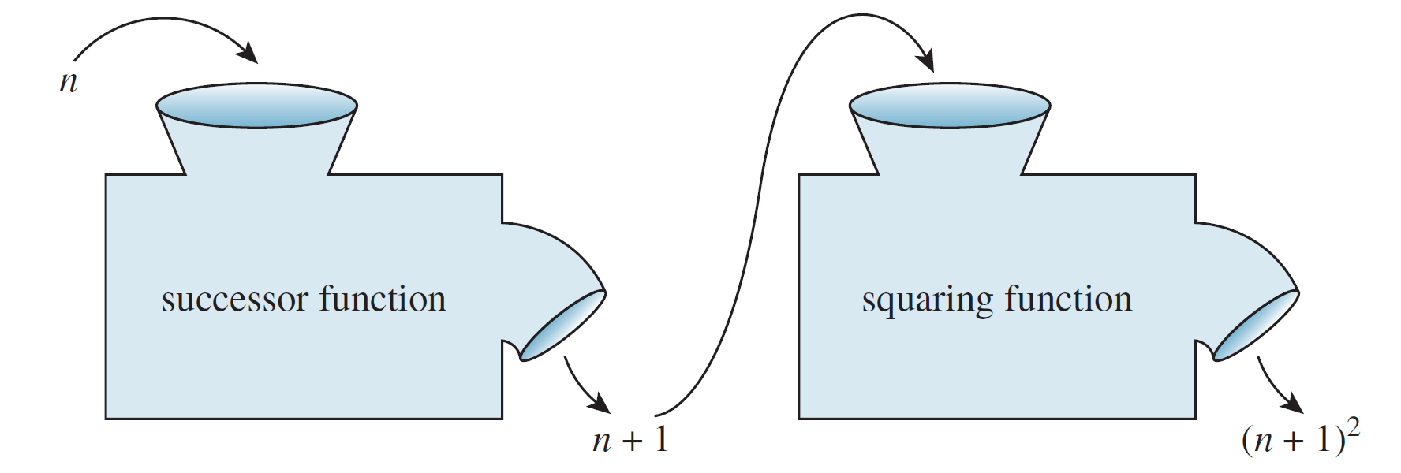
Composition of Functions
This is illustrated in the following drawing.
Combining functions in this way is called composing them; the resulting function is called the composition of the two functions.

Slide 5
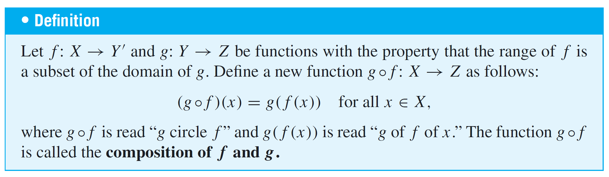
Composition of Functions
Note that the composition can be formed only if the output of the first function is acceptable input to the second function.
That is, the range of the first function must be contained in the domain of the second function.

Slide 6
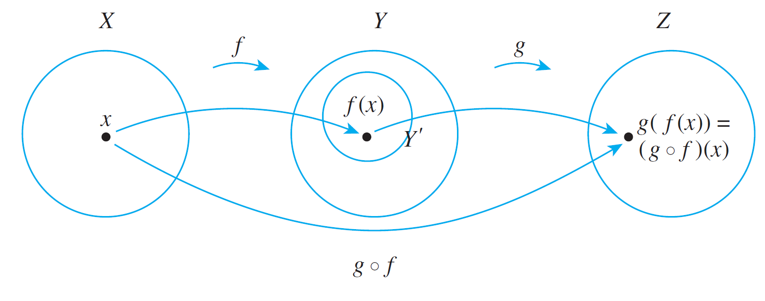
Composition of Functions
This definition is shown schematically below.

Slide 7
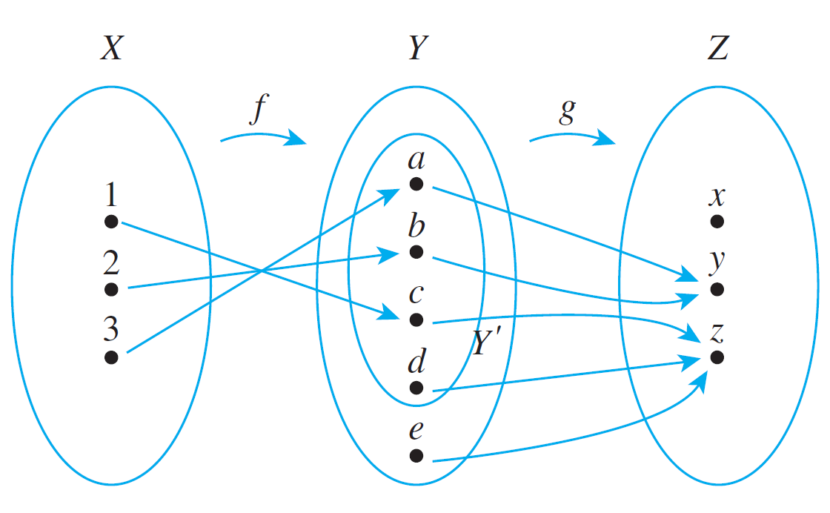
Example 2 – Composition of Functions Defined on Finite Sets
Let X = {1, 2, 3}, Y ′ = {a, b, c, d}, Y = {a, b, c, d, e}, and
Z = {x, y, z}. Define functions f : X → Y ′ and g: Y → Z by the arrow diagrams below.
Draw the arrow diagram for g ° f. What is the range
of g ° f ?

Slide 8
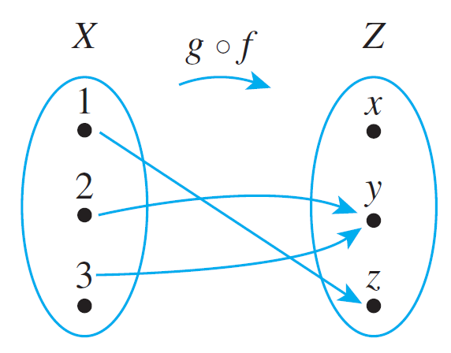
Example 2 – Solution
To find the arrow diagram for g ° f, just trace the arrows all the way across from X to Z through Y. The result is shown below.
The range of g ° f is {y, z}.

Slide 9
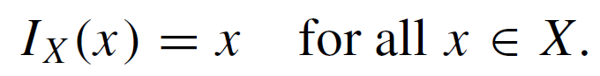
Composition of Functions
We have known that the identity function on a set X, I_{X}, is the function from X to X defined by the formula
That is, the identity function on X sends each element of X to itself. What happens when an identity function is composed with another function?

Slide 10
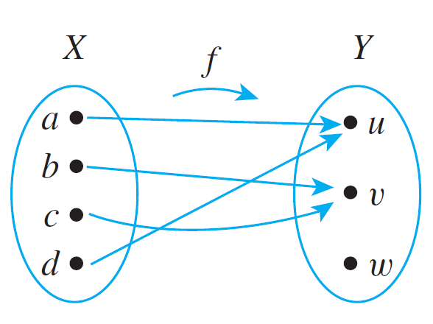
Example 3 – Composition with the Identity Function
Let X = {a, b, c, d} and Y = {u, v, w}, and suppose f : X → Y is given by the arrow diagram.
Find f ° I_{X} and I_{Y} ° f.

Slide 11
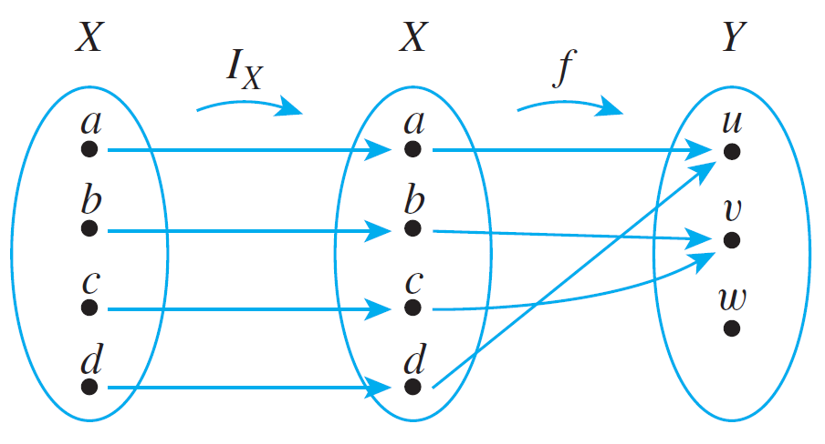


Example 3 – Solution
The values of f ° I_{X} are obtained by tracing through the arrow diagram shown below.
Note that for all elements x in X,

Slide 12
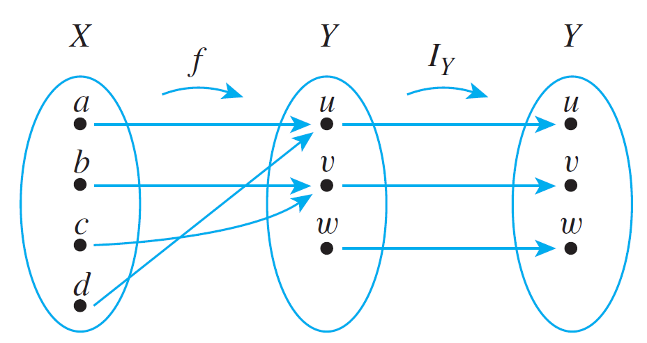
Example 3 – Solution
cont’d
By definition of equality of functions, this means that
f ° I_{X} = f.
Similarly, the equality I_{Y} ° f = f can be verified by tracing through the arrow diagram below for each x in X and noting that in each case, (I_{Y} ° f )(x) = f (x).

Slide 13
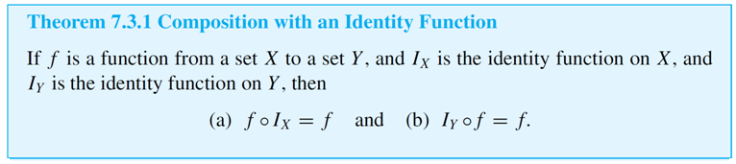
Composition of Functions
More generally, the composition of any function with an identity function equals the function.

Slide 14

Composition of Functions
Now let f be a function from a set X to a set Y, and suppose f has an inverse function f ^{–1}. We have known that f ^{–1} is the function from Y to X with the property that
What happens when f is composed with f ^{–1}? Or when f ^{–1} is composed with f ?

Slide 15
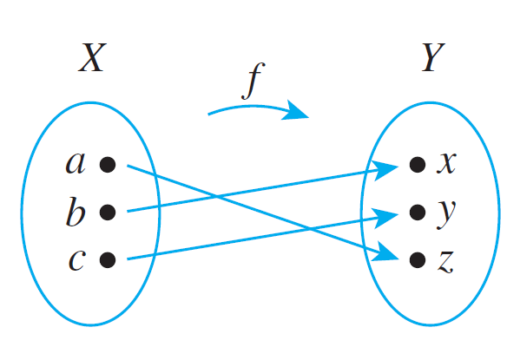
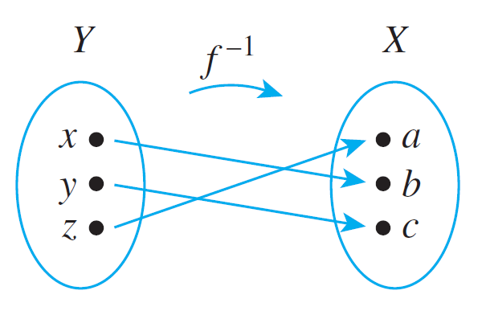
Example 4 – Composing a Function with Its Inverse
Let X = {a, b, c} and Y = {x, y, z}. Define f : X → Y by the following arrow diagram.
Then f is one-to-one and onto. Thus f ^{–1} exists and is found by tracing the arrows backwards, as shown below.

Slide 16
Example 4 – Composing a Function with Its Inverse
cont’d
Now f ^{–1} ° f is found by following the arrows from X to Y by f and back to X by f ^{–1}.
If you do this, you will see that
and
Thus the composition of f and f ⁻¹ sends each element to itself.

Slide 17


Example 4 – Composing a Function with Its Inverse
cont’d
So by definition of the identity function,
In a similar way, you can see that

Slide 18
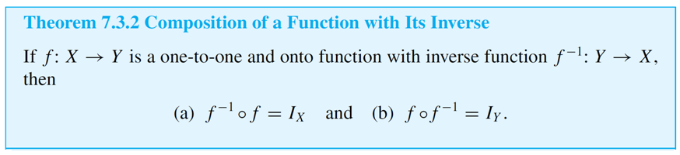
Composition of Functions
More generally, the composition of any function with its inverse (if it has one) is an identity function. Intuitively, the function sends an element in its domain to an element in its co-domain and the inverse function sends it back again, so the composition of the two sends each element to itself.
This reasoning is formalized in Theorem 7.3.2.

Slide 19
Composition of One-to-One Functions

Slide 20
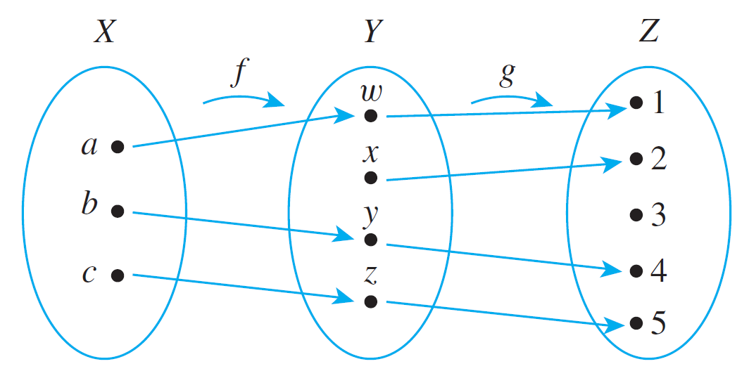
Composition of One-to-One Functions
The composition of functions interacts in interesting ways with the properties of being one-to-one and onto. What happens, for instance, when two one-to-one functions are composed? Must their composition be one-to-one?
For example, let X = {a, b, c}, Y = {w, x, y, z}, and Z = {1, 2, 3, 4, 5}, and define one-to-one functions f : X → Y and g: Y → Z as shown in the arrow diagrams of
Figure 7.3.1.
Figure 7.3.1

Slide 21
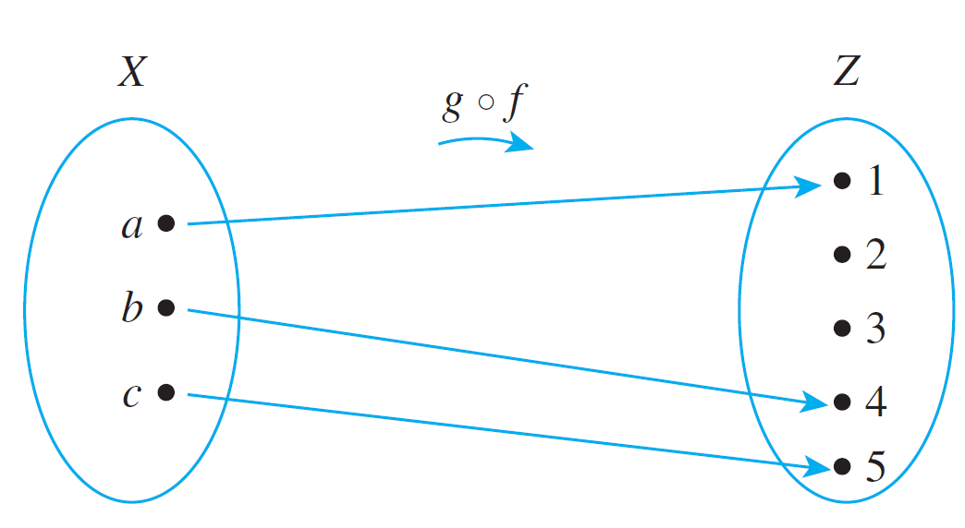
Composition of One-to-One Functions
Then g ° f is the function with the arrow diagram shown in Figure 7.3.2.
From the diagram it is clear that for these particular functions, the composition is one-to-one.
Figure 7.3.2

Slide 22
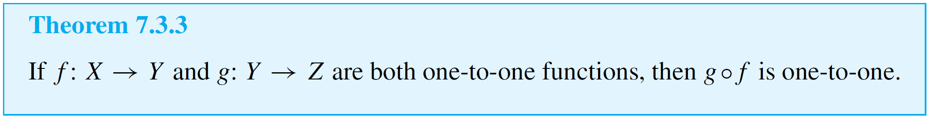
Composition of One-to-One Functions
This result is no accident. It turns out that the compositions of two one-to-one functions is always one-to-one.

Slide 23
Composition of Onto Functions

Slide 24
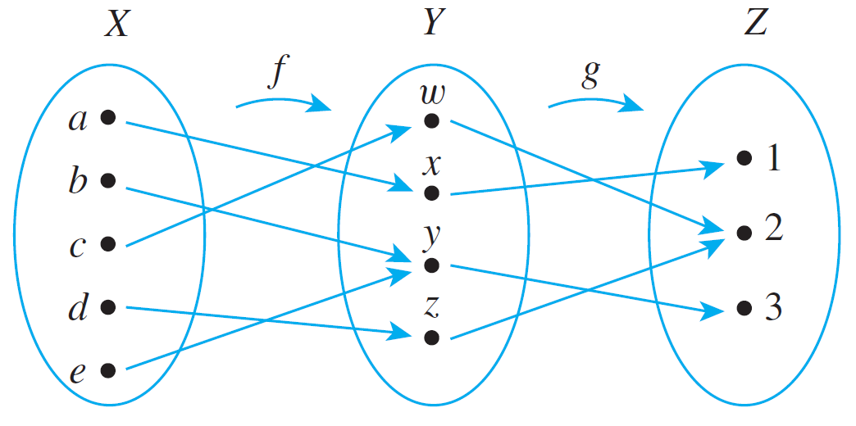
Composition of Onto Functions
Now consider what happens when two onto functions are composed. For example, let X = {a, b, c, d, e},
Y = {w, x, y, z}, and Z = {1, 2, 3}.
Define onto functions f and g by the following arrow diagrams.

Slide 25
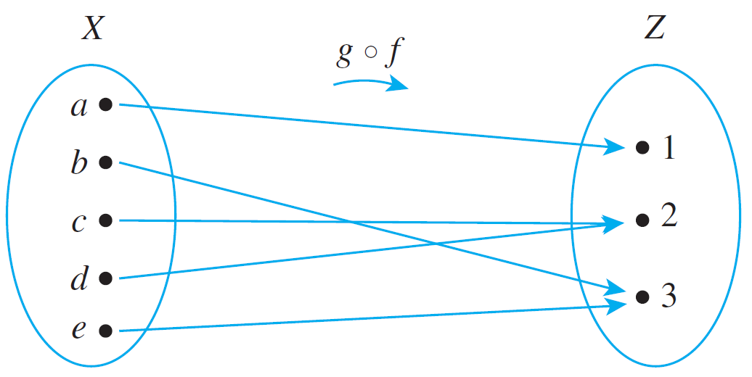
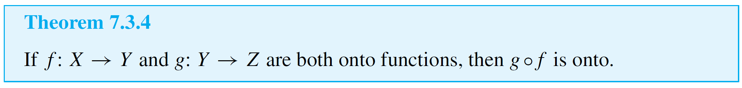
Composition of Onto Functions
Then g ° f is the function with the arrow diagram shown below.
It is clear from the diagram that g ° f is onto.
It turns out that the composition of any two onto functions (that can be composed) is onto.

Slide 26
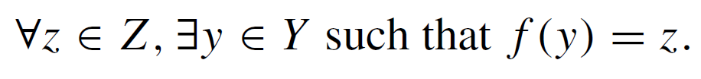
Example 5 – An Incorrect “Proof” That a Function Is Onto
To prove that a composition of onto functions is onto, a student wrote,
“Suppose f : X → Y and g: Y → Z are both onto.
Then
and

Slide 27
Example 5 – An Incorrect “Proof” That a Function Is Onto
cont’d
So
and thus g ° f is onto.”
Explain the mistakes in this “proof.”
Solution:
To show that g ° f is onto, you must be able to meet the following challenge: If someone gives you an element z in Z (over which you have no control), you must be able to explain how to find an element x in X such that
(g ° f )(x) = z.

Slide 28

Example 5 – Solution
cont’d
Thus a proof that g ° f is onto must start with the assumption that you have been given a particular but arbitrarily chosen element of Z. This proof does not do that.
Moreover, note that statement simply asserts that f is onto. An informal version of is the following: Given any element in the co-domain of f, there is an element in the domain of f that is sent by f to the given element.
Use of the symbols x and y to denote these elements is arbitrary.

Slide 29

Example 5 – Solution
cont’d
Any other two symbols could equally well have been used. Thus, if we replace the x and y in by u and v, we obtain a logically equivalent statement, and the “proof” becomes the following:
“Suppose f : X → Y and g: Y → Z are both onto.
Then
and

Slide 30

Example 5 – Solution
cont’d
So (??!)
and thus g ° f is onto.”
From this logically equivalent version of the “proof,” you can see that the statements leading up to the word So do not provide a rationale for the statement that follows it.
The original reason for writing So was based on a misinterpretation of the meaning of the notation.

